Slide 1
Chapter 10 IMAGE SEGMENTATION
The whole is equal to the sum of its parts.
Euclid
The whole is greater than the sum of its parts.
Max Wertheimer
Segmentation of nontrivial images is one of the most difficult tasks in image processing.
Segmentation accuracy determines the eventual success or failure of computerized analysis procedures.

Slide 2
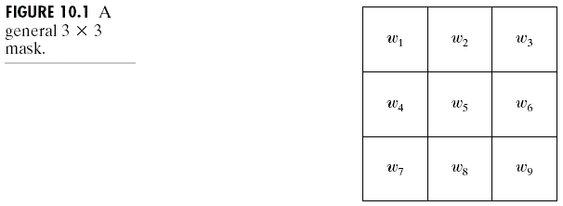
Detection of Discontinuities
The basic types of gray-level discontinuities in a digital image: points, lines, and edges.
Consider the 3×3 mask shown in Fig. 10.1, the response of the mask at any point in the image is:
R = w₁z₁ + w₂z₂ + · · · + w₉z₉
= , (10.1-1)
where z_{i} is the gray level of the pixel associated with mask coefficient w_{i}.

Slide 3
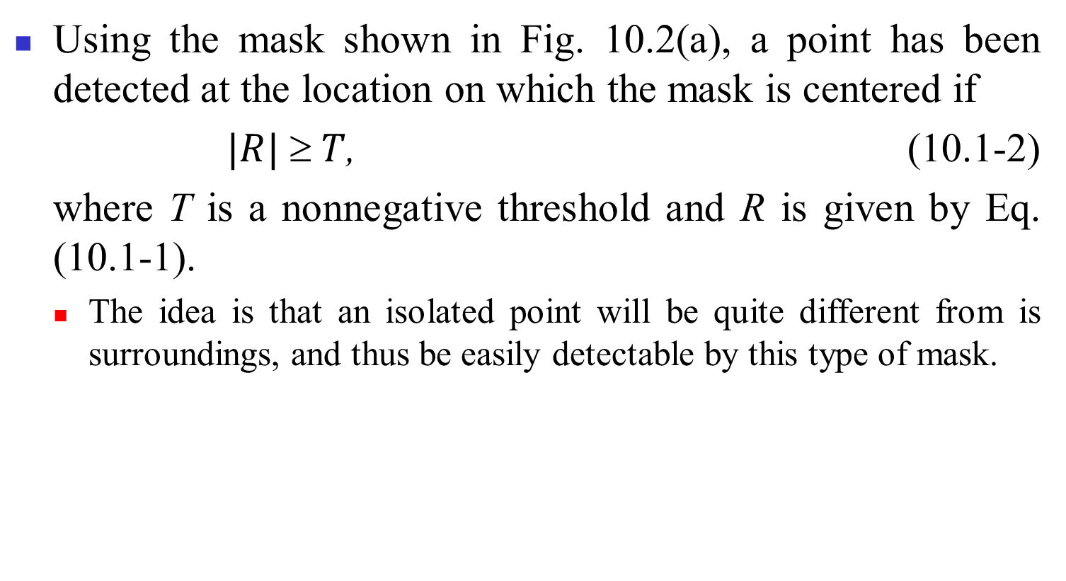
Point detection

Slide 4
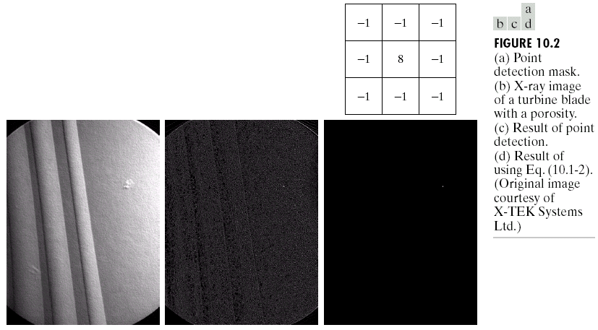
Fig. 10.2(b) shows an X-ray image, Fig. 10.2(c) shows the result of applying the point detection mask to Fig. 10.2(b), and Fig. 10.2(d) shows the result of using Eq. (10.1-2) with T = 90% of the highest absolute pixel value of the image in Fig. 10.2(c).

Slide 5
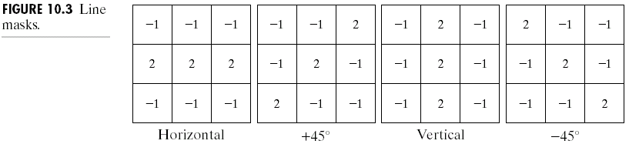
Line detection
Fig. 10.3 shows four line detection masks.
Let R₁, R₂, R₃, and R₄ denote the responses of the four masks in Fig. 10.3. If |R_{i}| > |R_{j}| for all j ≠ i, then the point is said to be more likely associated with a line in the direction of mask i.
Fig. 10.4(a) shows a digital (binary) portion of a wire-bond mask for an electronic circuit, Fig. 10.4(b) shows the absolute value of the result after processing with the –45° line detector, and Fig. 10.4(c) shows the result of thresholding image in Fig. 10.4(b).

Slide 6
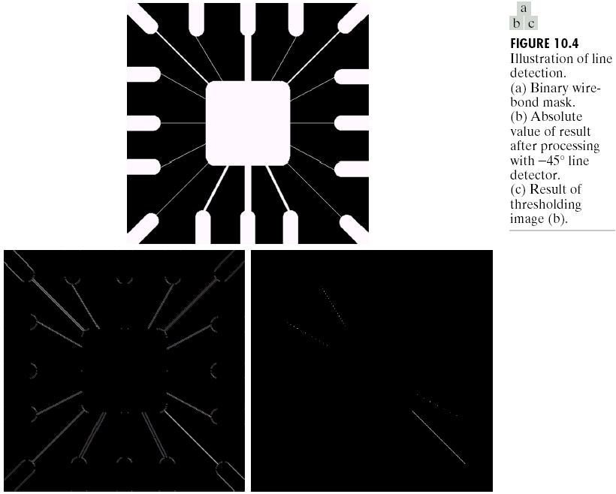

Slide 7
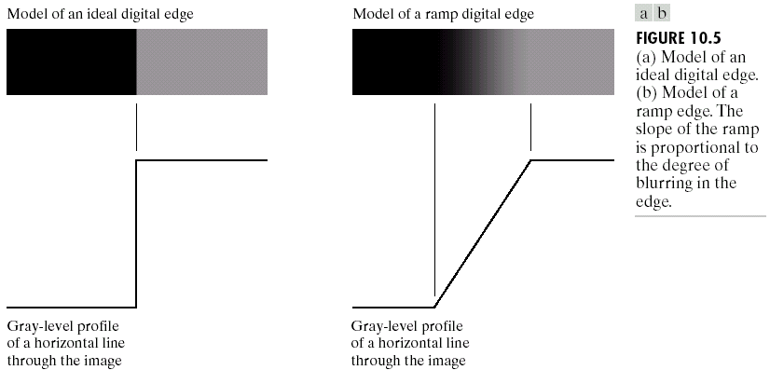
Edge detector
As shown in Fig. 10.5(a), an ideal edge is a set of connected pixels, each of which is located at an orthogonal step transition in gray level.
Practically, edges are more closely modeled as having a “ramplike” profile, as that shown in Fig. 10.5(b). The slope of the ramp is inversely proportional to the degree of blurring in the edge.
Blurred edges tend to be thick and sharp edges tend to be thin.

Slide 8
Fig. 10.6(a) shows the image from which the close-up in Fig. 10.5(b) was extracted and Fig. 10.6(b) shows a horizontal gray-level profile of the edge between the two regions, where the first and second derivatives of the gray-level profile are included.
The first derivative is a positive pulse and the second derivative includes a positive impulse and a negative impulse.
The magnitude of the first derivative can be used to detect the presence of an edge at a point in an image. The sign of the second derivative can be used to determine whether an edge pixel lies on the dark or light side of an edge.
Two properties of the second derivative:
(1) it produces two values for every edge in an image (an undesirable feature);
(2) an imaginary straight line joining the extreme positive and negative values of the second derivative would cross zero near the midpoint of the edge.
This zero-crossing property of the second derivative is quite useful for locating the centers of thick edges.

Slide 9
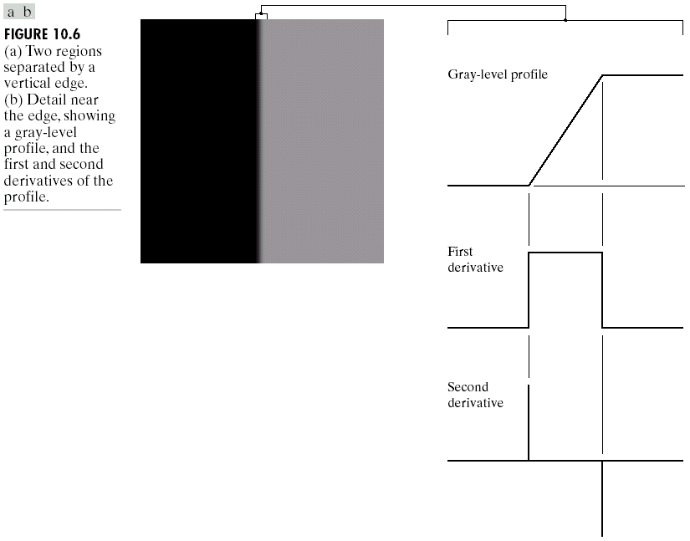

Slide 10
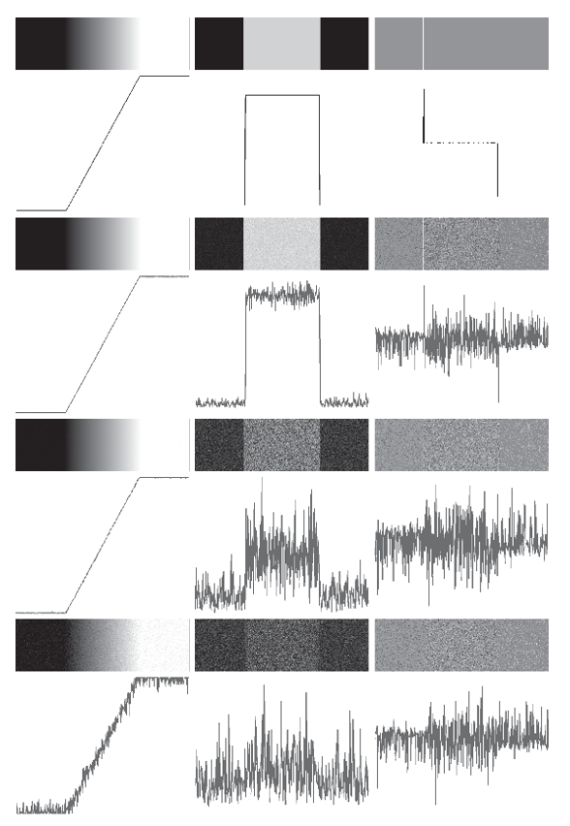
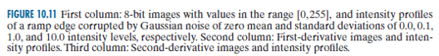
Fig. 10.7(a) shows a ramp image and its first and second derivative gray-level profiles, and Fig. 10.7(b)~(d) shows the images in Fig. 10.7(a) corrupted by additive Gaussian noise with zero mean and σ = 0.1, 1.0, and 10.0, respectively.

Slide 11
We define a point in an image as being an edge point if its two-dimensional first-order derivative is greater than a specified threshold.
A set of such points that are connected according to a predefined criterion of connectedness is by definition an edge.
A key problem in segmentation is to assemble edge segments into longer edges.

Slide 12
Gradient operators
The gradient of an image f(x, y) at location (x, y) is defined as the vector:
(10.1-3)
The gradient vector points in the direction of maximum rate of change of f at coordinates (x, y).
An important quantity in edge detection is the magnitude of this vector:
(10.1-4)
which gives the maximum rate of increase of f(x, y) per unit distance in the direction of ∇f. It is a common practice to refer to ∇f also as the gradient.

Slide 13
The direction of the gradient vector is:
, (10.1-5)
where the angle is measured with respect to the x-axis. The direction of an edge at (x, y) is perpendicular to the direction of the gradient vector at that point.
Let the 3×3 mask in Fig.10.8(a) represent the gray levels in a neighborhood of an image. One of the simple ways to implement a first-order partial derivative at point z₅ is the Roberts cross-gradient operators:
G_{x} = (z₉ – z₅), (10.1-6)
G_{y} = (z₈ – z₆), (10.1-7)
which are the masks shown in Fig. 10.8(b).

Slide 14
The 3×3 masks are (Fig. 10.8(d) and (e)):
G_{x} = (z₇ + z₈ + z₉) – (z₁ + z₂ + z₃), (10.1-8)
G_{y} = (z₃ + z₆ + z₉) – (z₁ + z₄ + z₇), (10.1-9)
which are called the Prewitt operators.
A slight variation of these two equations uses a weight of 2 in the center coefficient:
G_{x} = (z₇ + 2z₈ + z₉) – (z₁ + 2z₂ + z₃), (10.1-10)
G_{y} = (z₃ + 2z₆ + z₉) – (z₁ + 2z₄ + z₇), (10.1-11)
which are called the Sobel operators (Fig. 10.8(f) and (g)).
An approximation of the gradient by absolute values:
(10.1-12)

Slide 15
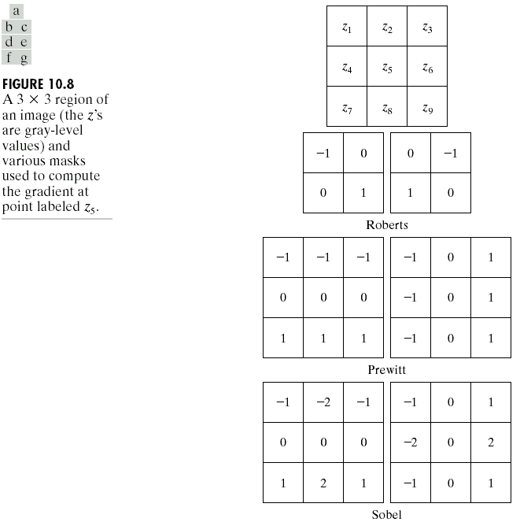

Slide 16
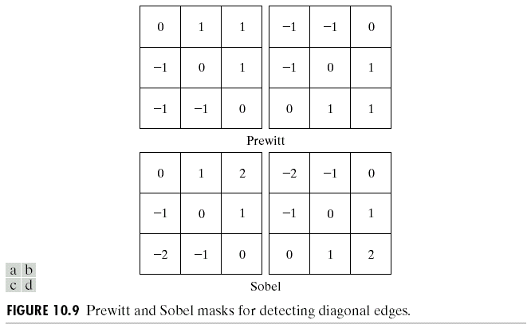
The two additional Prewitt and Sobel masks for detecting discontinuities in the diagonal directions are shown in Fig. 10.9.

Slide 17
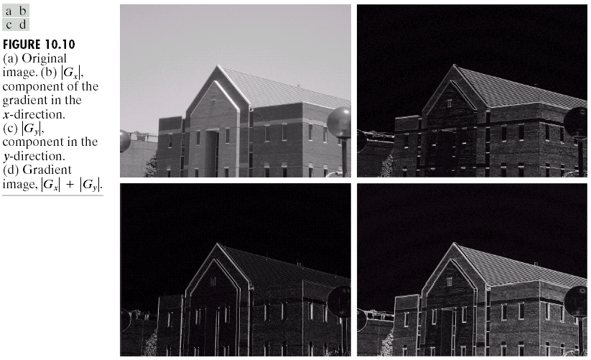
Figure 10.10 illustrates the response of the two components of the gradient, |G_{x}| and | G_{y}|, as well as the gradient image formed from the sum of these two components, as shown in Fig. 10.10(b) and (c). Fig. 10.10(c) shows the gradient image, |G_{x}| + |G_{y}|.

Slide 18
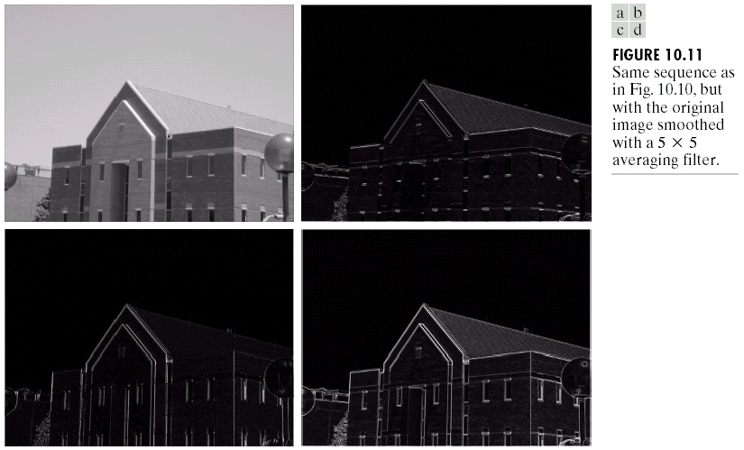
After the original image is smoothed with a 5×5 average filter, the corresponding image, the |G_{x}| image, the |G_{y}| image, and the gradient image, |G_{x}| + |G_{y}|, are shown in Fig. 10.11.

Slide 19
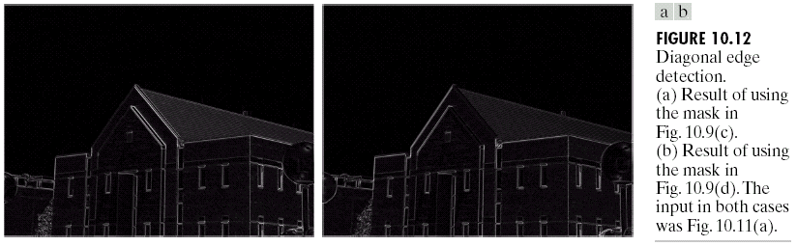
Based the smoothed image in Fig. 10.11(a), the diagonal edge detection using the masks Fig. 10.9(c) and (d) are shown in Fig. 10.12(a) and (b), respectively.

Slide 20
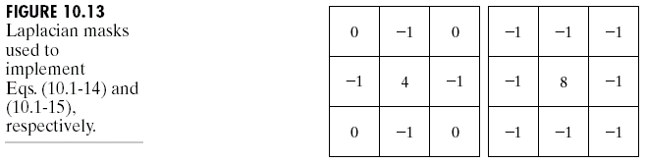
The Laplacian
The Laplacian of a 2-D function f(x, y) is a second-order derivation defined as:
(10.1-13)
For a 3×3 region, one approximation is:
∇²f = 4z₅ – (z₂ + z₄ + z₆ + z₈) (10.1-14)
where the z’s are defined in Fig. 10.8(a).
A digital approximation including the diagonal neighbors is given by
∇²f = 8z₅ – (z₁ + z₂ + z₃ + z₄ + z₆ + z₇ + z₈ + z₉). (10.1-15)
Masks for implementing these two equations are shown in Fig. 10.13.

Slide 21
The Laplacian generally is not used in its original form for edge detection for several reasons:
(1) As a second-order derivative, the Laplacian typically is
unacceptably sensitive to noise.
(2) The magnitude of the Laplacian produces double edges,
an undesirable effect because it complicates
segmentation.
(3) The Laplacian is unable to detect edge direction.
The role of the Laplacian in segmentation consists of
(1) using its zero-crossing property for edge location, or
(2) using it for the complementary purpose of establishing whether a pixel is on the dark or light side of an edge.

Slide 22
The Laplacian is combined with smoothing as a precursor to finding edges via zero-crossings. Consider the smoothing function:
, (10.1-16)
where r² = x² + y² and σ is the standard deviation. The Laplacian of h (the second derivative of h with respect to r) is:
(10.1-17)
This function is commonly referred to as the Laplacian of a Gaussian (LoG) because h(r) is in the form of a Gaussian function.
Fig. 10.14 shows a 3-D plot, image, and cross section of the LoG function. Also shown is a 5×5 mask that approximates ∇²h.
Due to its shape, the Laplacian of a Gaussian sometimes is called the Mexican hat function.

Slide 23
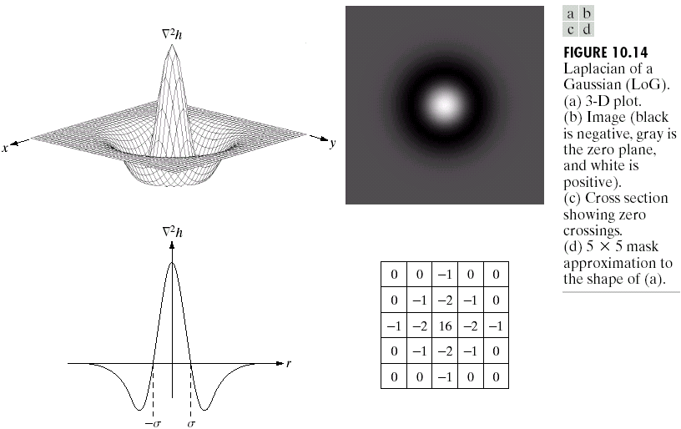
The purpose of the Gaussian function in the LoG formulation is to smooth the image, and the purpose of the Laplacian operator is to provide an image with zero crossings used to establish the location of edges. Smoothing the image reduces the effect of noise and, in principle, it counters the increased effect of noise caused by the second derivatives of the Laplacian.

Slide 24
Fig. 10.15(a) shows the angiogram image.
Fig. 10.15(b) shows the Sobel gradient of this image.
Fig. 10.15(c) is a spatial Gaussian function (with a standard deviation of five pixels) used to obtain a 27×27 spatial smoothing mask.
Fig. 10.15(d) is the spatial mask used to implement Eq. (10.1-15).
Fig. 10.15(e) is the LoG image obtained by smoothing the original image with the Gaussian smoothing mask, followed by application of the Laplacian mask.
Fig. 10.15(f) shows the thresholded LoG (+ → white, − → black), and Fig. 10.15(g) shows the estimated zero crossings.

Slide 25
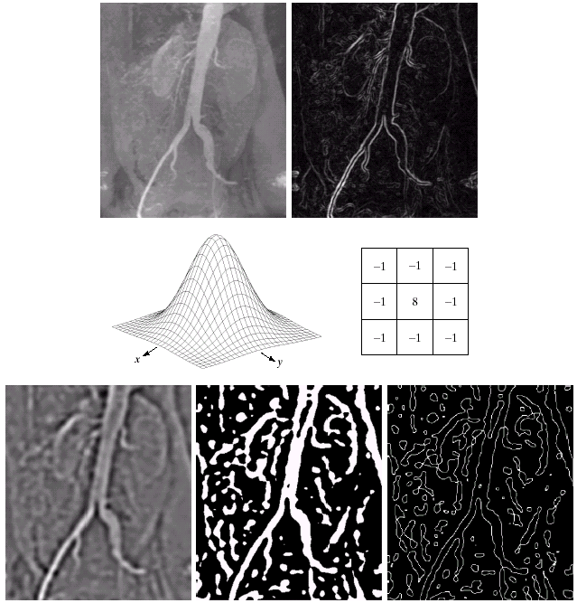
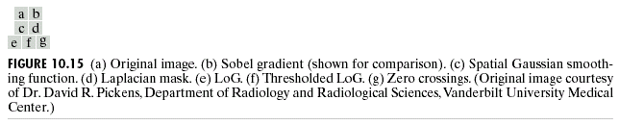

Slide 26
Edge Linking and Boundary Detection-local processing
A simple approach to linking edge points is to analyze the characteristics of pixels in a small neighborhood about every point (x, y) in an image.
Two principal properties for establishing similarity of edge points:
(1) the strength of the response of the gradient operator used to produce the edge pixel;
(2) the direction of the gradient vector.
Two edge points are similar in magnitude if
, (10.2-1)
where E is a nonnegative threshold.

Slide 27
Two edge points are similar in direction if
, (10.2-2)
where A is a nonnegative angle threshold.
Note that the direction of the edge at (x, y) is perpendicular to the direction of the gradient vector at that point.
Fig. 10.16(a) shows an image, Fig. 10.16(b) and (c) shows vertical and horizontal edges by using the horizontal and vertical Sobel operators, and Fig. 10.16(d) shows the results of edge linking.

Slide 28
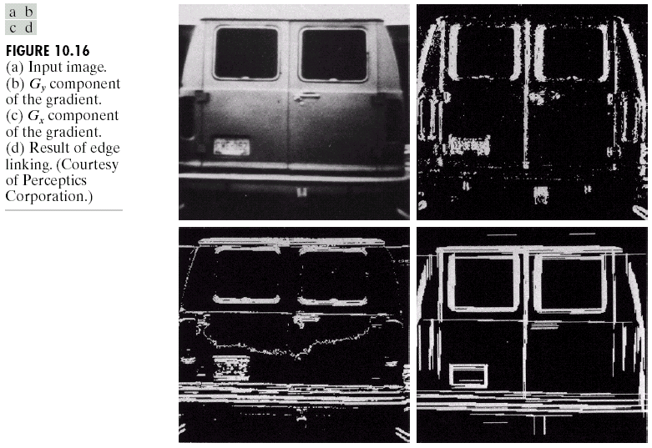

Slide 29
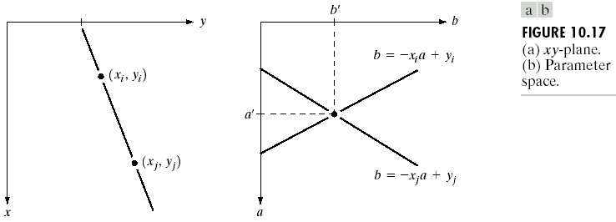
Global edge linking via Hough transform
Given n points in an image, suppose that we want to find subsets of these points that lie on straight lines.
To consider all possible combinations, we have to find n(n – 1)/2 ~ n² lines and perform n[n(n – 1)]/2 ~ n³ comparisons of every point to all lines.
Consider a point (x_{i}, y_{i}) and the general equation of a straight line in slope-intercept form, y_{i} = ax_{i} + b. Infinitely many lines pass through (x_{i}, y_{i}), but they all satisfy the equation y_{i} = ax_{i} + b for varying values of a and b.
Writing this equation as b = –x_{i}a + y_{i} and considering the ab-plane (also called parameter space) yields the equation of a single line for a fixed pair (x_{i}, y_{i}), as shown in Fig. 10.17.

Slide 30
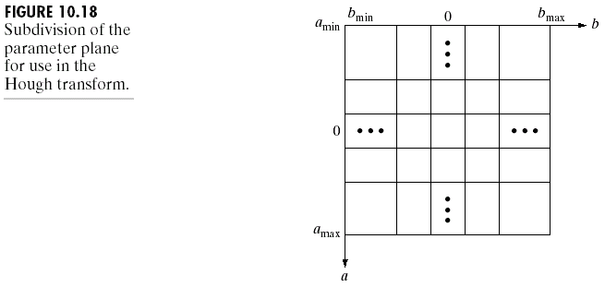
As shown in Fig. 10.18, the Hough transform subdivides the parameter space into accumulator cells, where (a_{max}, a_{min}) and (b_{max}, b_{min}) are the expected ranges of slope and intercept values.
Initially, these cells are set to zero.
If a choice of a_{p} results in solution b_{q}, A(p, q) = A(p, q) + 1. At the end of this procedure, a value of Q in A(i, j) corresponds to Q points in the xy-plane lying on the line y = a_{i}x + b_{j}.
The number of subdivisions in the ab-plane determines the accuracy of the colinearity of these points.

Slide 31
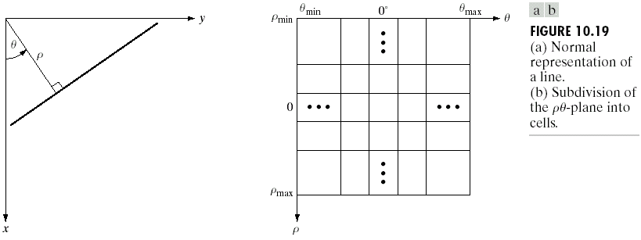
The line equation y = ax + b is not feasible if the line approaches the vertical (slope ≈ ∞). The normal representation of a line (without the above difficulty):
(10.2-3)
Fig. 10.19 shows the geometrical interpretation of the parameters (ρ, θ) used in Eq. (10.2-3).
Instead of straight lines, the loci are sinusoidal curves in the ρθ–plane.

Slide 32
Fig. 10.20(a) shows an image of 5 labeled points, each of these points is mapped onto the ρθ–plane in Fig. 10.20(b), the colinearity detection property of the Hough transform is shown in Fig. 10.20(c), and Fig. 10.20(d) shows the fact that the Hough transform exhibits a reflective adjacency relationship at the right and left edges of the parameter space (change size at the ±90° boundaries).
The Hough transform is applicable to any function of the form g(v, c) = 0, where v is a vector of coordinates and c is a vector of coefficients.
For example, the points lying on a circle:
, (10.2-4)
can be detected by a 3-D parameter space with cubelike cells and accumulators of the form A(i, j, k).

Slide 33
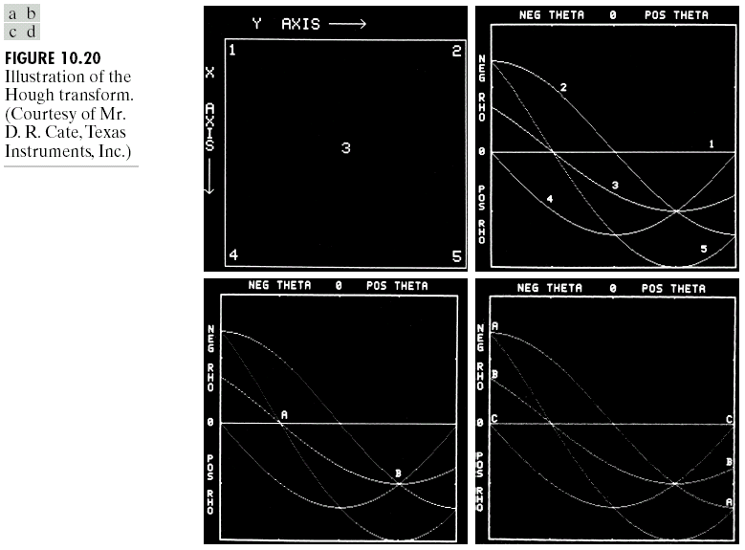

Slide 34
The edge-liking approach based on the Hough transform:
1. Compute the gradient of an image and threshold it to
obtain a binary image.
2. Specify subdivisions in the ρθ–plane.
3. Examine the counts of the accumulator cells for high
pixel concentrations.
4. Examine the relationship (principally for continuity)
between pixels in a chosen cell.
Fig. 10.21(a) shows an infrared image, Fig. 10.21(b) shows the thresholded gradient image, Fig. 10.21(c) shows the Hough transform of the gradient image, and Fig. 10.21(d) shows the linked results.
The linked criteria used in Fig. 10.21(d):
(1) the pixels belonged to one of the three accumulator cells with the highest count, and
(2) no gaps were longer than 5 pixels.

Slide 35
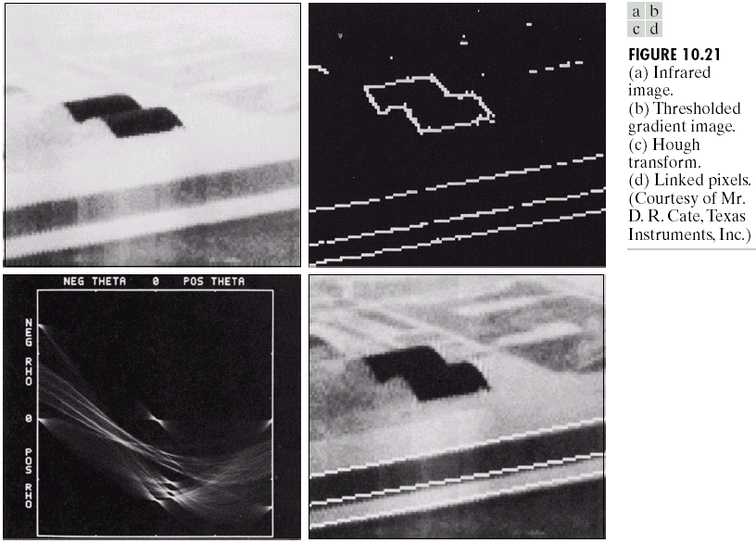

Slide 36
Global edge linking via graph-theoretic techniques
A graph G = (N, U) is a finite, nonempty set of nodes N, together with a set U of unordered pairs of distinct elements of N. Each pair (n_{i}, n_{j}) of U is called an arc. A graph in which the arcs are directed is called a directed graph.
If an arc is directed from node n_{i} to node n_{j}, then n_{j} is said to be a successor of the parent node n_{i}. The process of identifying the successors of a node is called expansion of the node.
In each graph, we define levels such that level 0 consists of a single node, called the start or root node, and the nodes in the last level are called goal nodes.

Slide 37
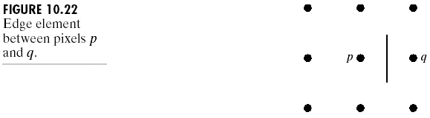
A cost c(n_{i}, n_{j}) can be associated with every arc(n_{i}, n_{j}). A sequence of nodes n₁, n₂, …, n_{k}, with each node n_{i} being a successor of node n_{i-1}, is called a path from n₁ to n_{k}. The cost of the entire path is:
(10.2-5)
As shown in Fig. 10.22, an edge element is defined as the boundary between two pixels p and q.

Slide 38
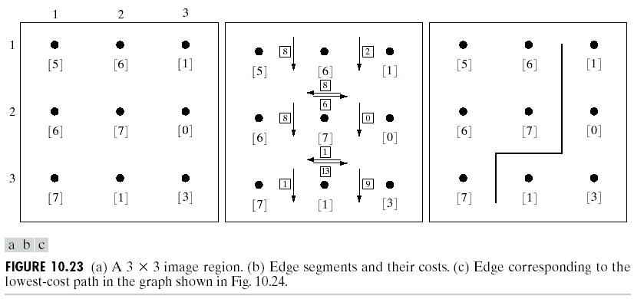
As shown in Fig. 10.23, the associated cost of pixels p and q is defined as:
, (10.2-6)
where H is the highest gray-level value in the image (7 in this case), and f(p) and f(q) are the gray-level values of p and q, respectively.
The point p is on the right-hand side of the direction of travel along edge elements.
For simplification, it is assumed that edges start in the top row and terminate in the last row.

Slide 39
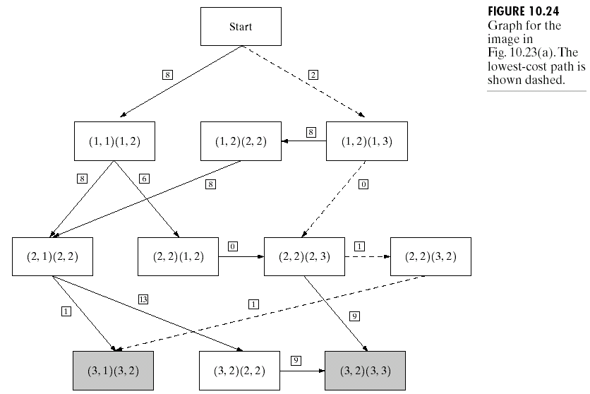
Fig. 10.24 shows the graph for this problem. Each node (rectangle) in the graph corresponds to an edge element from Fig. 10.23.
An arc exists between two nodes if the two corresponding edge elements taken in succession can be part of an edge.
Goal nodes are shown shaded. The minimum cost path is shown dashed, and the edge corresponding to this path is shown in Fig. 10.23(c).

Slide 40
Optimal search algorithm
Let r(n) be an estimate on the cost of a minimum-cost path from the start node s to a goal node, where the path is constrained to go through n.
(10.2-7)
where g(n) can be chosen as the lowest-cost path from s to n found so far, and h(n) is estimated by using any available heuristic information.

Slide 41
A graph search algorithm using r(n):
Step 1: Mark the start node OPEN and set g(s) = 0.
Step 2: If no node is OPEN, exit with failure; otherwise, continue.
Step 3: Mark CLOSED the OPEN node n whose estimate r(n)
computed from Eq. (10.2-7) is smallest.
Step 4: If n is a goal node, exit with the solution path obtained by
tracing back through the pointers; otherwise, continue.
Step 5: Expand node n, generating all of its successors. (If there are
no successors go to step 2.)
Step 6: If a successor n_{i} is not marked, set
r(n_{i}) = g(n) + c(n, n_{i}),
mark it OPEN, and direct pointers from it back to n.
Step 7: If a successor n_{i} is marked CLOSED or OPEN, update its
value by letting
g’(n_{i}) = min [g(n_{i}), g(n) + c(n, n_{i})].
Mark OPEN those CLOSED successors whose g’ values were thus lowered and redirect to n the pointers from all nodes whose g’ values were lowered. Go to step 2.

Slide 42
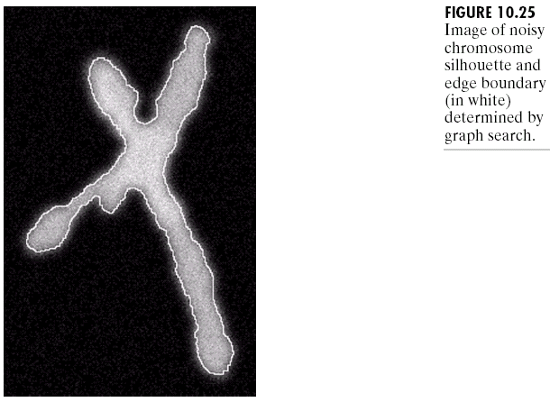
If h(n) is lower bound on the cost of the minimal-cost path from n to a goal node, the algorithm yields an optimal path to a goal (A* algorithm).
If no heuristic information is available, i.e., h(n) = 0, the algorithm reduces to the uniform-cost algorithm.
Fig. 10.25 shows an image of a noisy chromosome silhouette and an edge found by the above algorithm.

Slide 43
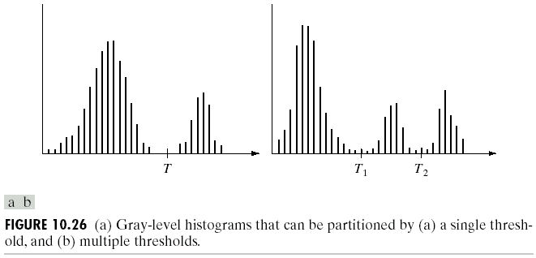
Foundation of Thresholding
Fig. 10.26(a) shows an image f(x, y) composed of eight objects on a dark background, where object and background pixels have gray levels grouped into two dominant modes.
We may select a threshold T such that if f(x, y) > T, f(x, y) is an object point; otherwise, it is a background point.
As shown in Fig. 10.26(b), multilevel thresholding classifies a point f(x, y) as belonging to one object class if T₁ < f(x, y) ≤ T₂, to the other object class if f(x, y) > T₂, and to the background if f(x, y) ≤ T₁.

Slide 44
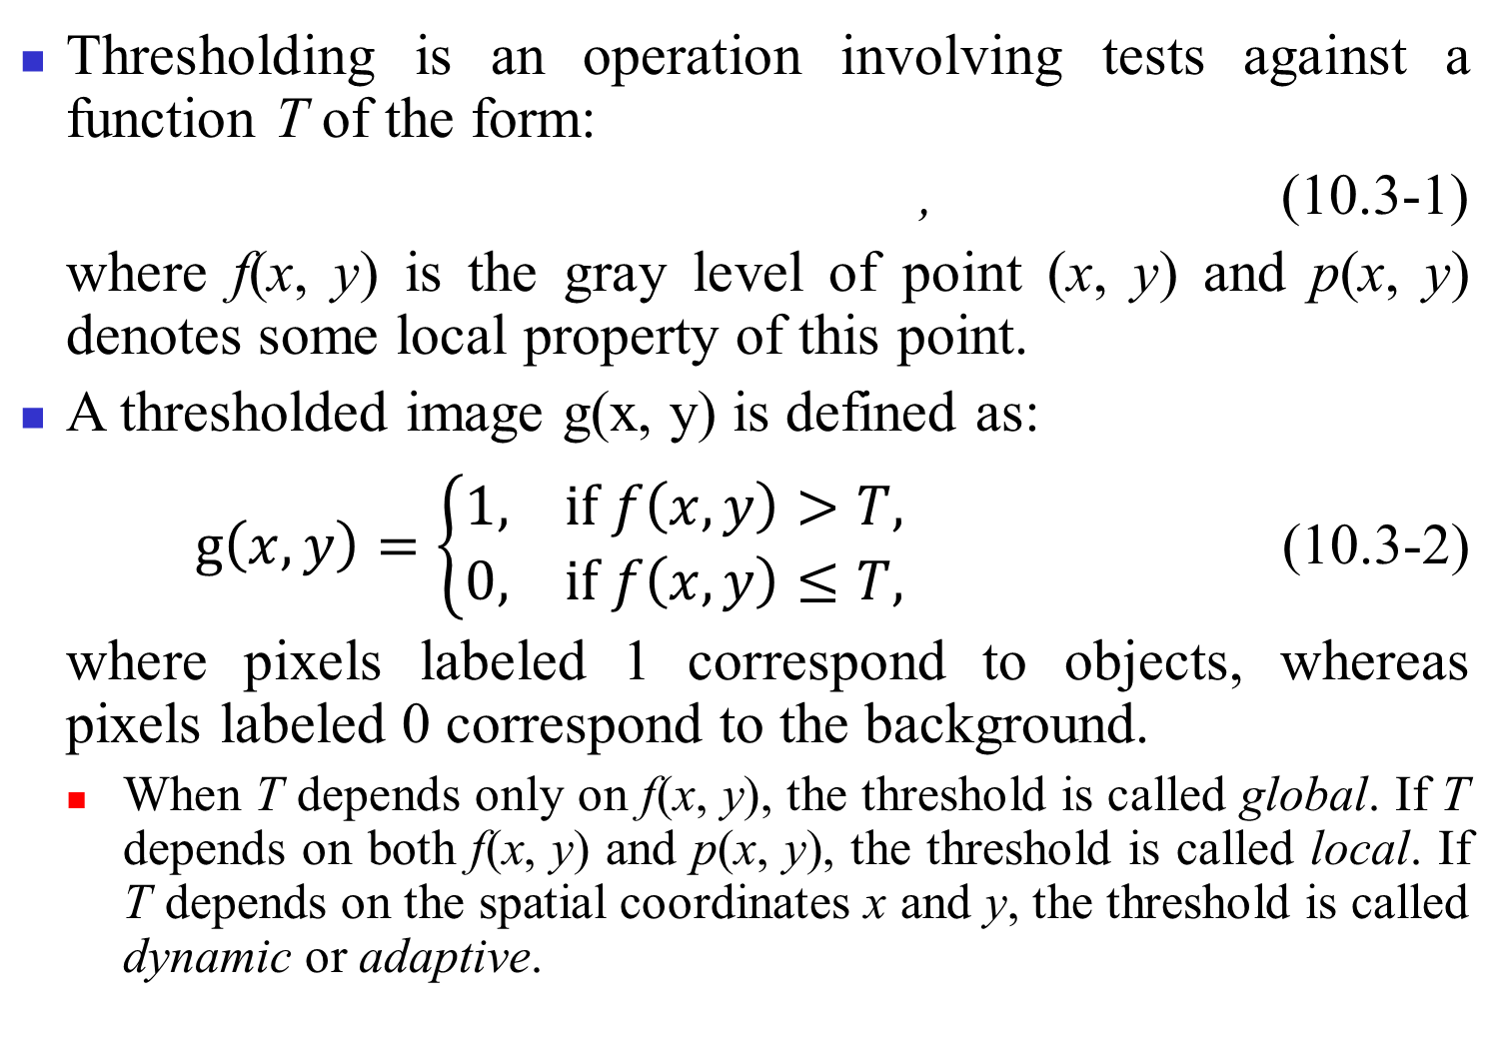
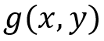

Slide 45
Role of illumination
Fig. 10.27(a) shows a computer generated reflectance function, and Fig. 10.27(b) shows its histogram.
Multiplying the reflectance function by the illumination function in Fig. 10.27(c) yields the image in Fig. 10.27(d). Fig. 10.27(e) shows the histogram of Fig. 10.27(d).
⇒ The image resulting from poor illumination can be quite difficult to segment.

Slide 46
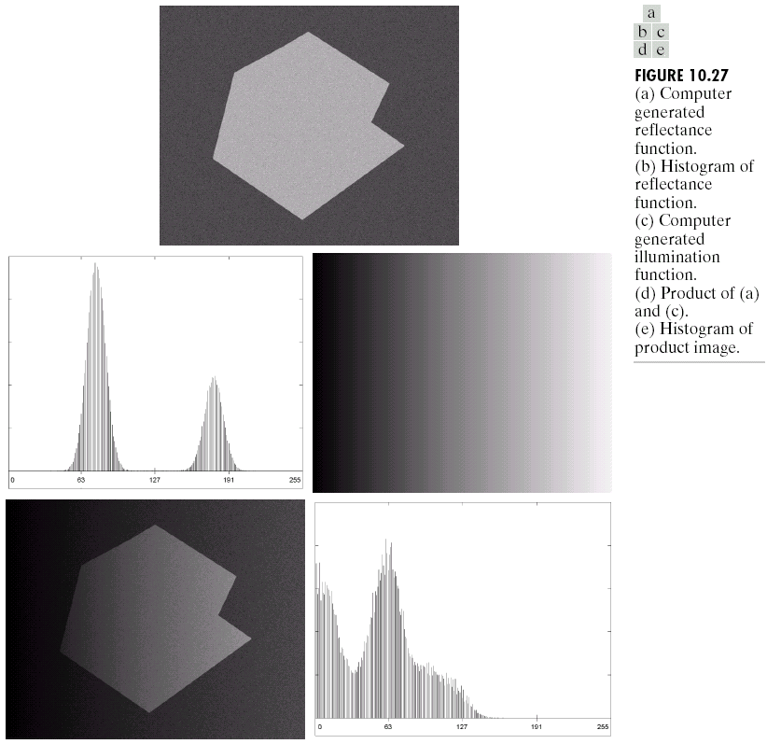

Slide 47
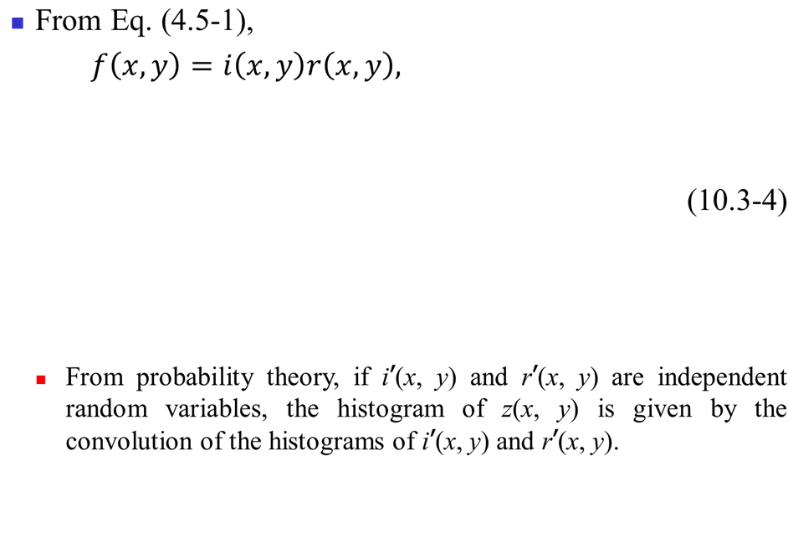
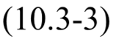

Slide 48
If i’(x, y) had a broader histogram (resulting from nonuniform illumination), the convolution process would smear the histogram of r’(x, y), yielding a histogram for z(x, y) whose shape could be quite different from that of the histogram of r’(x, y).
If the illumination source is available, a solution to compensate for nonuniformity is to project the illumination pattern onto a constant, white reflective surface. This yields an image g(x, y) = ki(x, y), where k is a constant that depends on the surface and i(x, y) is the illumination pattern.
Then, for any image f(x, y) = i(x, y)r(x, y) obtained with the same illumination function, simply dividing f(x, y) by g(x, y) yields a normalized function h(x, y) = f(x, y) / g(x, y) = r(x, y) / k. Thus, if r(x, y) can be segmented by using a single threshold T, then h(x, y) can be segmented by using a single threshold of value T / k.

Slide 49
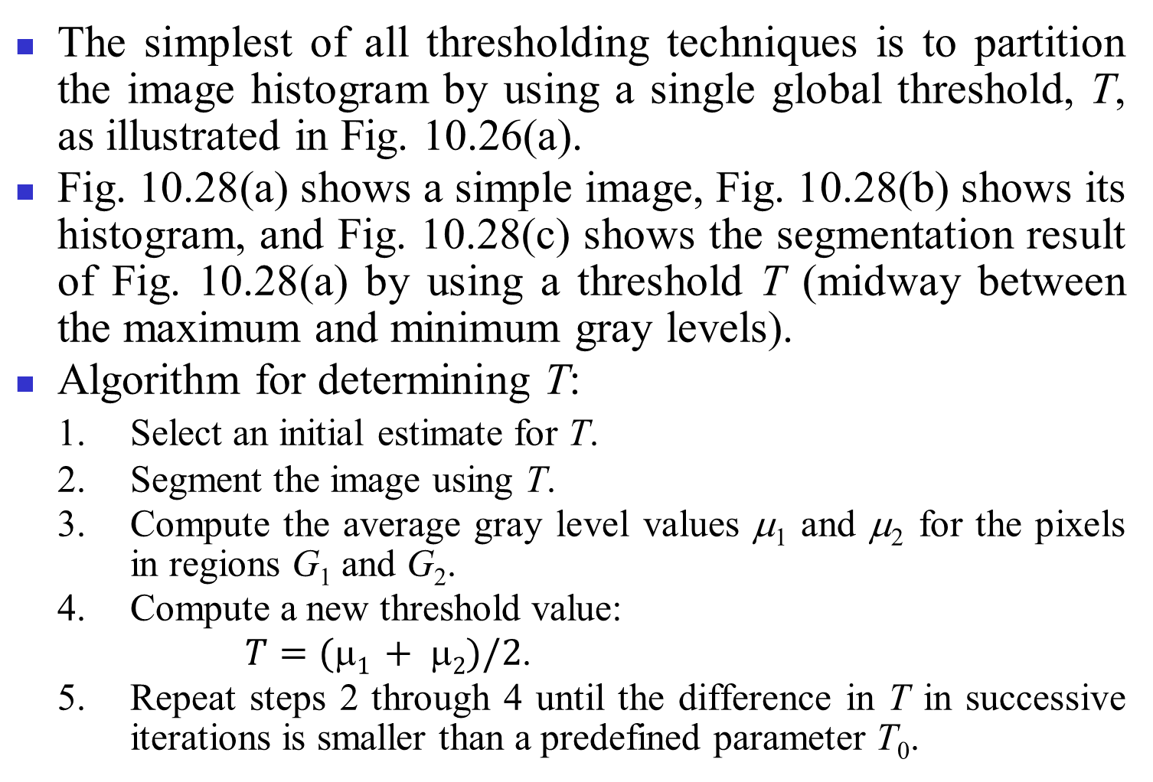
Global thresholding

Slide 50
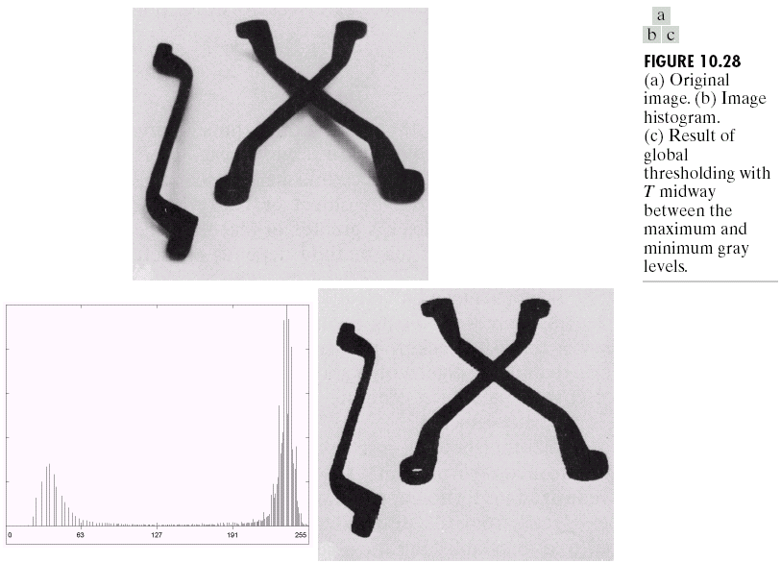

Slide 51
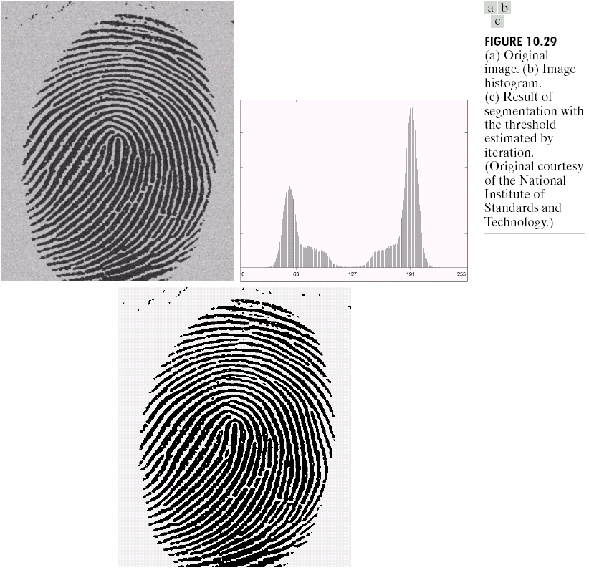
Fig. 10.29(a) shows the original image, Fig. 10.29(b) is the
image histogram,
and Fig. 10.29(c)
s h o w s t h e
threshlding result
using T = 125
(determined by
t h e a b o v e
algorithm).

Slide 52
Adaptive thresholding
We can divide the original image into subimages and then utilize different thresholds to segment subimages.
The key issues:
(1) how to subdivide the image, and
(2) how to estimate the threshold for each resulting subimage.
Fig. 10.30(a) shows the image from Fig. 10.27(d), and Fig. 10.30(b) shows the result of thresholding the image with a global threshold placed in the valley of its histogram. In Fig. 10.30(c), the image is divided into smaller subimages and Fig. 10.30(d) shows the result of adaptive thresholding.

Slide 53
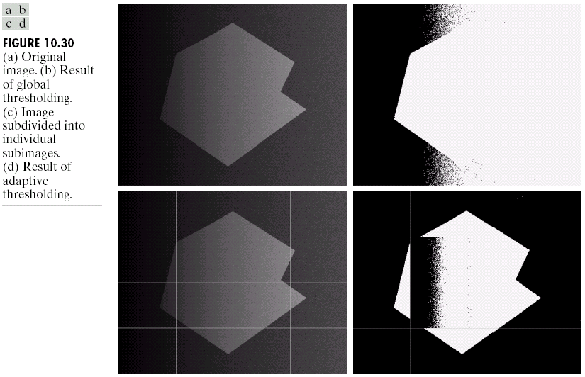

Slide 54
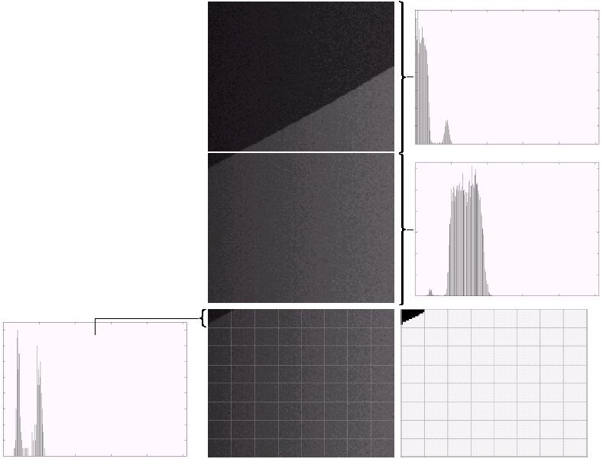
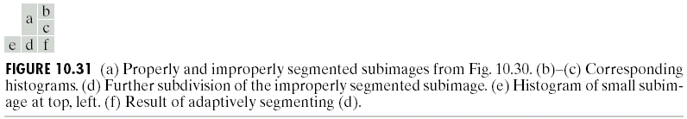
Fig. 10.31(a) shows the top improperly segmented subimage from Fig. 10.30(c) and the subimage directly above it. Fig. 10.31(d) shows the failed subimage further subdivided into much smaller subimages so that the adaptive segmenting
result is shown in Fig.
10.31(f).

Slide 55
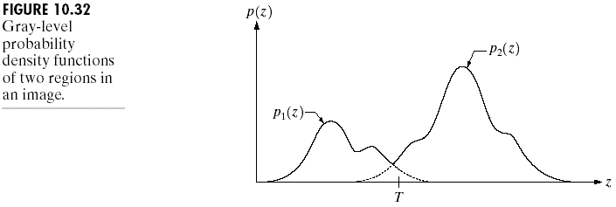
Optimal global and adaptive thresholding
Let z denote gray-level values and an image contain only two principal gray-level regions, as shown in Fig. 10.32. Then the mixed PDF of the image is:
(10.3-5)
where P₁ and P₂ are the probabilities of occurrence of the two classes (object and background) of pixels with
. (10.3-6)
The objective is to select the value of T that minimizes the average error in making the decisions that a given pixel belongs to an object or to the background.

Slide 56
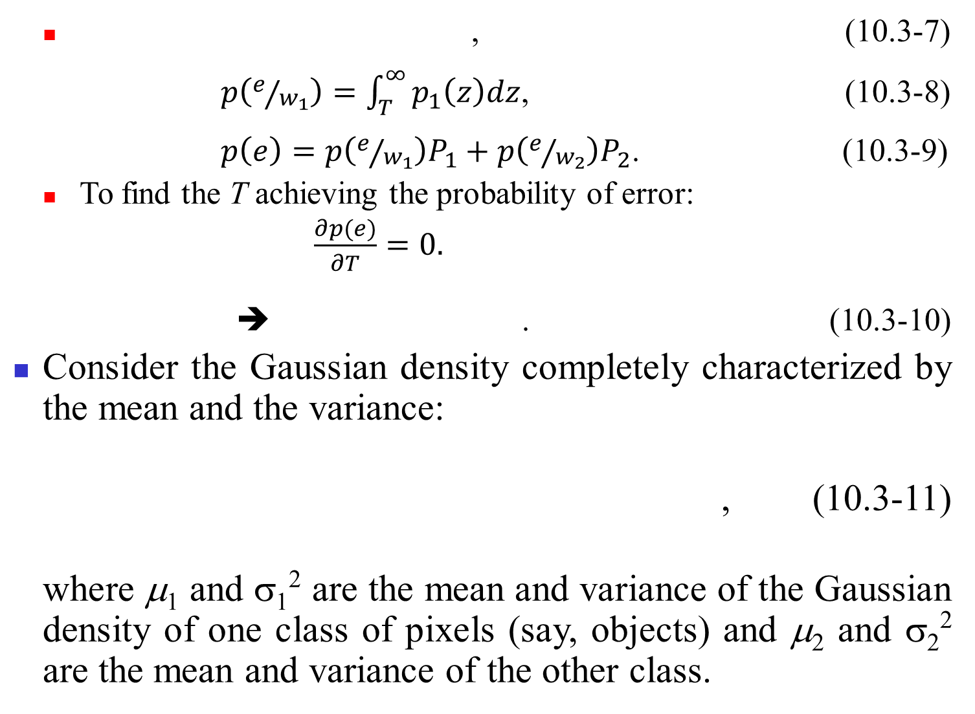

Slide 57
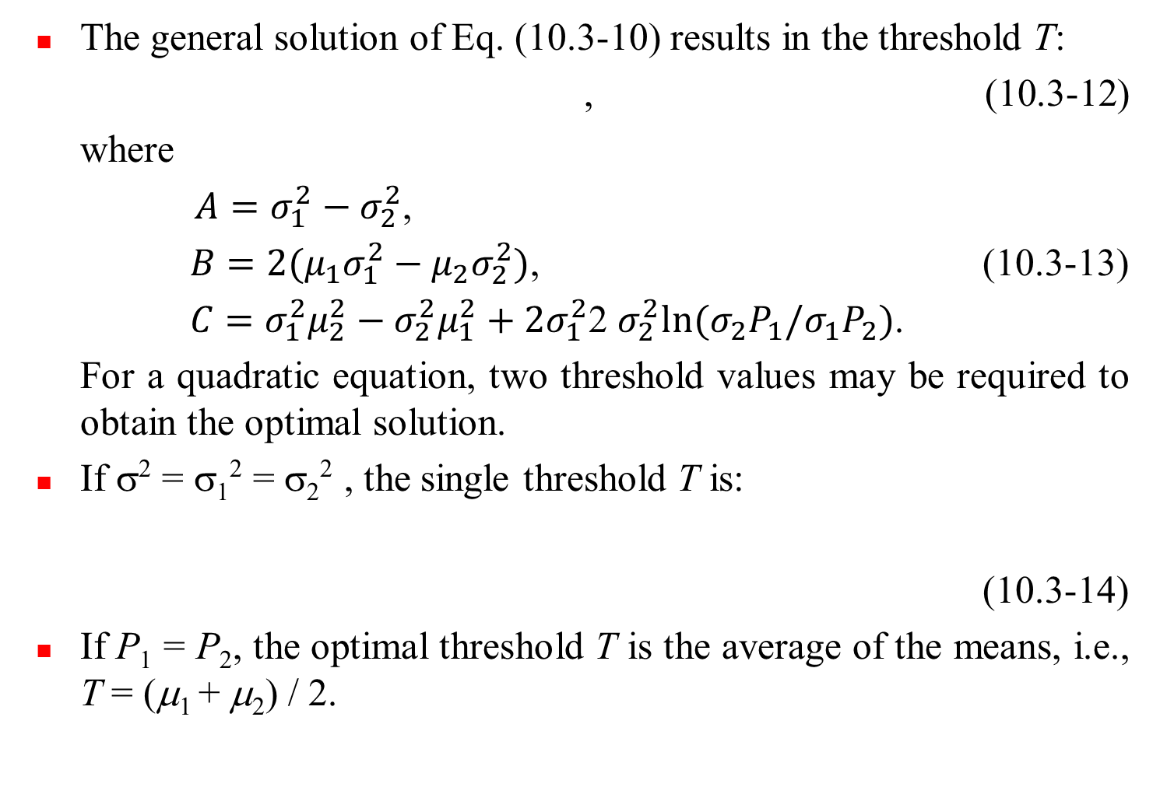

Slide 58
The mean square error between the (continuos) mixture density p(z) and the (discrete) image histogram h(z_{i}) is:
, (10.3-15)
where an n-point histogram is assumed. The principal reason for estimating the complete density is to determine the presence or absence dominant modes in the PDF.
To outline automatically the boundaries of heart ventricles in cardioangiograms, all images are preprocessed as follows.
(1) Each pixel was mapped with a log function to counter exponential effects caused by radioactive absorption.
(2) An image obtained before application of the contrast medium was subtracted from each image captured after the medium was injected in order to remove the spinal column present in both images.
(3) Several angiograms were summed in order to reduce random noise.

Slide 59
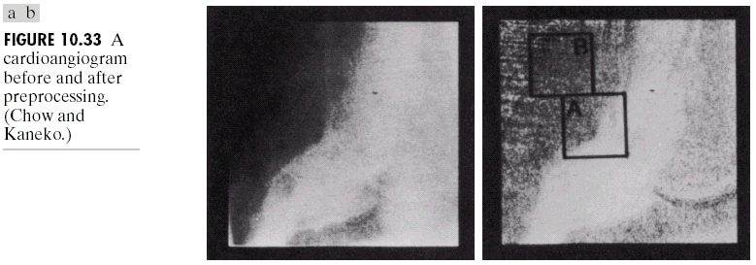
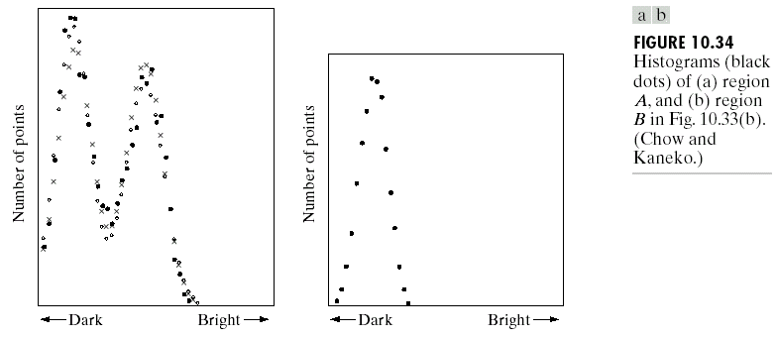
Fig. 10.33 shows a cardioangiogram before and after preprocessing (containing regions A and B).
Fig. 10.34(a) and (b) shows the histograms of the regions marked A and B in Fig. 10.33(b), where the histogram of region A is bimodal and that of region B is unimodal.

Slide 60
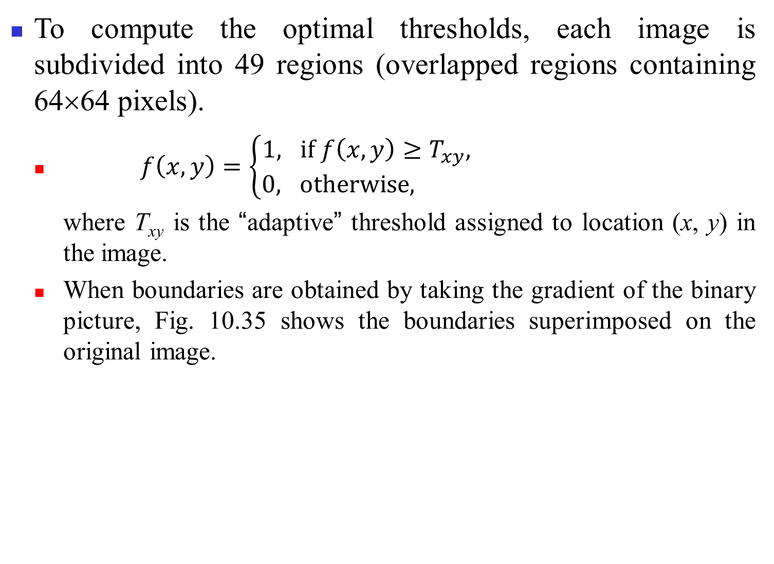
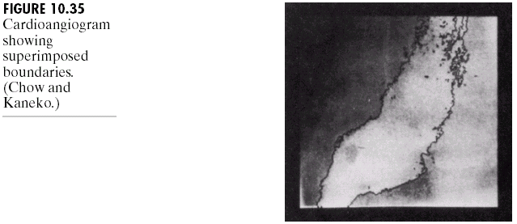

Slide 61
Boundary characteristics for histogram improvement and local thresholding
The average value of the Laplacian is 0 at the transition of an edge, so in practice the valleys of histograms formed from the pixels selected by a gradient/Laplacian criterion can be expected to be sparsely populated, resulting in the highly desirable deep valleys in the local histogram.
The gradient ∇f and the Laplacian ∇²f may be used to form a three-level image, as follows:
(10.3-16)
where the symbols 0, +, and – represent any three distinct gray levels and T is a threshold. Note that the symbols + and – are reversed for a light object on a dark background.

Slide 62
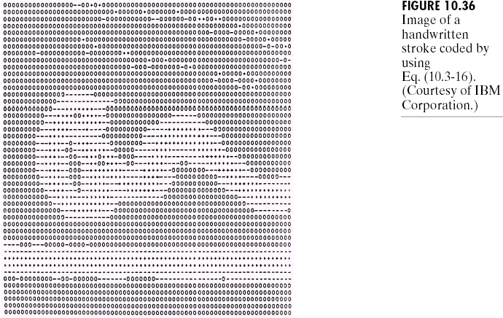
Using Eq. (10.3-16),
(1) all pixels that are not on an edge are labeled 0;
(2) all pixels on the dark side of an edge are labeled +; and
(3) all pixels on the light side of an edge are labeled –.
Fig. 10.36 shows the labeling for an image of a dark, underlined stroke written on a light background.
The information obtained with this procedure can be used to generate a segmented binary image, in which 1’s correspond to objects and 0’s correspond to the background.

Slide 63
(1) The horizontal or vertical transition from a light background to a dark object must be characterized by the occurrence of a – followed by a + in s(x, y).
(2) The interior of the object is composed of pixels that are labeled either 0 or +.
(3) Finally, the transition from the object back to the background is characterized by the occurrence of a + followed by a –.
Thus a horizontal or vertical scan line containing a section of an object has the following structure:
(···)(–, +)(0 or +)(+, –)(···)
Fig. 10.37(a) shows an image of an ordinary scenic back check, Fig. 10.38 shows the histogram as a function of gradient values for pixels with gradients greater than 5, and Fig. 10.37(b) shows the segmented image by using Eq. (10.3-16) with T at or near the midpoint of the valley.

Slide 64
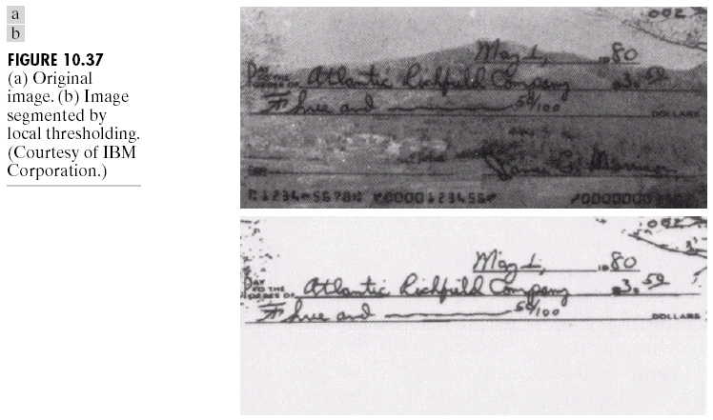
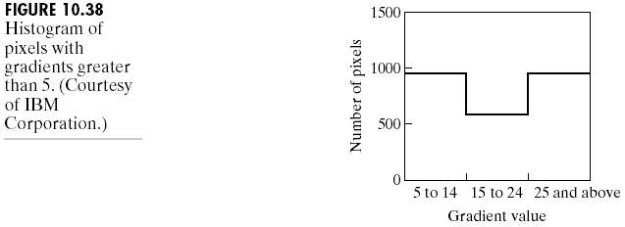

Slide 65

Multispectral thresholding
Fig. 10.39(a) shows a monochrome picture of a color photograph. The original color image consists of 3 16-level RGB images.
Fig. 10.39(b) is obtained by thresholding about one of the histogram clusters corresponding to facial tones.
Fig. 10.39(c) is obtained by thresholding about a cluster close to the red axis.

Slide 66
Region-Based Segmentation
Let R represent the entire image region. We may view segmentation as a process that partitions R into n subregions, R₁, R₂, …, R_{n}, such that
(a)
(b) R_{i} is a connected region, i = 1, 2, …, n,
(c) R_{i} ∩ R_{j} = ∅ for all i and j, i ≠ j,
(d) P(R_{i}) = TRUE for i = 1, 2, …, n,
(e) P(R_{i}∪R_{j}) = FALSE for i ≠ j.
Here, P(R_{i}) is a logical predicate defined over the points in set R_{i} and ∅ is the null set.
P(R_{i}) = TRUE deals with the properties satisfied by all the pixels in a segmented region. For example, all pixels in R_{i} have the same (or similar) gray level.

Slide 67
Region growing is a procedure that groups pixels or subregions into larger regions based on predefined criteria. The basic approach is to start with a set of “seed” points and from these grow regions by appending to each seed those neighboring pixels that have properties similar to the seed.
Selecting a set of one or more starting points often can be based on the nature of the problem. The selection of similarity criteria depends not only on the problem under consideration, but also on the type of image data available.
When the images are monochrome, region analysis must be carried out with a set of descriptors based on gray levels and spatial properties. However, descriptors alone can yield misleading results if connectivity or adjacency information is not used in the region-growing process.

Slide 68
Basically, growing a region should stop when no more pixels satisfy the criteria for inclusion in that region.
Fig. 10.40(a) shows an X-ray image of a weld containing several cracks and porosities.
Based the fact that pixels of defective welds tend to have the maximum gray value (255), the seed points are extracted and shown in Fig. 10.40(b).
Two criteria for region growing:
(1) The absolute gray-level difference between any pixel and the seed is less than 65.
(2) The pixel has to be connected at least one pixel in that region.
Fig. 10.40(c) shows the region growing result and Fig.10.40(d) shows the boundaries of segmented defective welds.

Slide 69


Slide 70

The histogram shown in Fig. 10.41 is an excellent example of a “clean” multimodal histogram of Fig. 10.40(a).
It is claimed that even with well-behaved histograms, multilevel thresholding is a difficult proposition.

Slide 71

Region splitting and merging
We can subdivide an image initially into a set of arbitrary, disjointed regions and then merge and/or split the regions in an attempt to satisfy the conditions.
We start with the entire region. If P(R) = FALSE, we divide the image into quadrants. If P is FALSE for any quadrant, we subdivide that quadrant into subquadrants, and so on, as illustrated in Fig. 10.42.

Slide 72

The procedure
1. Split into four disjoint quadrants any region R_{i} for which P(R_{i}) = FALSE.
2. Merge any adjacent regions R_{j} and R_{k} for which P(R_{j}∪R_{k}) = TRUE.
3. Stop when no further merging or splitting is possible.
Fig. 10.43(a) shows a simple image, Fig. 10.43(b) shows the result of the splitting and merging procedure, and Fig. 10.43(c) shows the result of thresholding.

Slide 73
Segmentation by Morphological Watersheds
The concept of watersheds is based on visualizing an image in three dimensions: two spatial coordinates versus gray levels.
Three types of points:
(a) points belonging to a regional minimum;
(b) points at which a drop of water, if placed at the location of any of those points, would fall with certainty to a single minimum;
(c) points at which water would be equally likely to fall to more than one such minimum.
The set of points satisfying condition (b) is called the catchment basin or watershed of that minimum.
The set of points satisfying condition (c) is called divide lines or watershed lines.

Slide 74
Suppose that a hole is punched in each regional minimum and that the entire topography is flooded from below by letting water rise through the holes at a uniform rate. When the rising water in distinct catchment basins is about to merge, a dam is built to prevent the merging.
The dam boundaries correspond to the divide lines of the watersheds.
Fig. 10.44(a) shows a simple gray-scale image and Fig. 10.44(b) is a topographic view, in which the height of the mountains is proportional to its gray-level values.
Suppose that a hole is punched in each regional minimum and the entire topography is flooded from below by letting water rise through the holes at a uniform rate.
Fig. 10.44(c)~(g) shows the flooding results, and Fig. 10.44(h) shows the final watershed (segmentation) lines.

Slide 75

One of the principal applications of watershed segmentation is in the extraction of nearly uniform (bloblike) objects from the background.
Usually, watershed segmentation applied to the gradient of an image, rather than to the image itself.

Slide 76


Slide 77
Dam construction
Dam construction is based on binary images, which are members of 2-D integer space Z². The simplest way to construct dams separating sets of binary points is to use morphological dilation.
Fig. 10.45(a) shows portions of two catchment basins at flooding step n - 1 and Fig. 10.45(b) shows the result at the next flooding step n, i.e., q.
Because water has spilled from one basin to the other at step n, a dam must be built.
Let M₁ and M₂ denote the sets of coordinates of points in two regional minima, and the set of coordinates of points in the catchment basin associated with these two minima at stage n - 1 of flooding be denoted by C_{n-1}(M₁) and C_{n-1}(M₂), respectively, as shown in Fig. 10.45(a).
Let C[n-1]: be the union of C_{n-1}(M₁) and C_{n-1}(M₂).
The two components from step n-1 can be extracted from the connected component q (step n) by performing the AND operation q ∩ C[n-1], where q is the enclosing region in Fig. 10.45(b).

Slide 78
Suppose that each of the connected components in Fig. 10.45(a) is dilated by the structuring element shown in Fig. 10.45(c), subject to two conditions:
(1) the dilation has to be constrained to q (this means that the center of the structuring element can be located only at points in q during dilation), and
(2) the dilation cannot be performed on points that would cause the sets being dilated to merge.
Fig. 10.45(d) shows that a first dilation pass (in light gray) expanded the boundary of each original connected component.
The only points in q that satisfy the two conditions under consideration describe the one-pixel-thick connected path shown crossed-hatched in Fig. 10.45(d). This path constitutes the desired separating dam at stage n of flooding.
Construction of the dam at this level of flooding is completed by setting all the points in the path just determined to a value greater than the maximum gray-level value of the image.

Slide 79



Slide 80
Watershed segmentation algorithm
Let M₁, M₂, …, M_{R} be sets denoting the coordinates of the points in the regional minima of an image g(x, y). Let C(M_{i}) and C_{n}(M_{i}) be a set denoting the coordinates of the points in the catchment basin associated with regional minimum M_{i} (with dam) and that are flooded at stage n, respectively.
Let T[n] represent the set of coordinates (s, t) for which
g(s, t) < n,
(10.5-1)
Geometrically, T[n] is the set of coordinates of points in g(x, y) lying below the plane g(x, y) = n.
The topography will be flooded in integer flood increments, from n = min + 1 to n = max + 1.
Suppose that the coordinates in T[n] that are below the plane g(x, y) = n are “marked” black, and all other coordinates are marked white.

Slide 81
C_{n}(M_{i}) is a binary image:
(10.5-2)
i.e., C_{n}(M_{i}) = 1 at location (x, y) if (x, y) ∈ C(M_{i}) AND
(x, y) ∈ T[n]; otherwise C_{n}(M_{i}) = 0.
Let C[n] denote the union of the flooded catchment basins portions at stage n:
(10.5-3)
then C[max + 1] is the union of all catchment basins:
(10.5-4)
The numbers of elements in both C_{n}(M_{i}) and T[n] are monotonously increased as n increases.
C[n-1] is a subset of C[n] and C[n] is a subset of T[n]. Each connected component of C[n-1] is contained in exactly one connected component of T[n].

Slide 82
Let Q denote the set of connected components in T[n]. Then, for each connected component q ∈ Q[n], there are three possibilities:
(a) q ∩ C[n-1] is empty,
(b) q ∩ C[n-1] contains one connected component of
C[n-1],
(c) q ∩ C[n-1] contains more than one connected component of C[n-1].
(1) Condition (a) occurs when a new minimum is encountered, in which case connected component q is incorporated into C[n-1] to form C[n].
(2) Condition (b) occurs when q lies within the catchment basin of some regional minimum, in which case q is incorporated into C[n-1] to form C[n].
(3) Condition (c) occurs when all, or part, of a ridge separating two or more catchment basins is encountered. A dam must be built within q.

Slide 83

c
Fig. 10.46(a) and (b) shows an image and its gradient. Fig. 10.46(c) shows the watershed lines of the gradient image and Fig. 10.46(d) shows the segmentation boundaries superimposed on the original image.

Slide 84

Use of Markers
Direct application of the watershed segmentation algorithm generally leads to oversegmentation due to noise and other local irregularities of the gradient, as illustrated example shown in Fig. 10.47.
An approach used to control oversegmentation is based on the concept of markers.
A marker is a connected component belonging to an image.
We have internal markers associated with objects of interest, and external markers associated with the background.

Slide 85
Two principal steps for marker selection:
(1) preprocessing;
(2) definition of a set of criteria that markers must satisfy.
An appropriate preprocessing scheme is applying a smoothing filter.
An internal marker is defined if
(1) a region that is surrounded by points of higher “altitude;”
(2) such that the points in the region form a connected component;
(3) in which all the points in the connected component have the same gray-level value.
After smoothing, the internal markers are shown as light gray (bloblike regions) in Fig. 10.48(a).
The watershed lines are defined as the external markers in Fig. 10.48(a), which partition the image into regions.

Slide 86

We can apply the watershed segmentation algorithm to each individual region containing a single object and its background. The result is shown in Fig. 10.48(b).

Slide 87
Spatial Motion Segmentation Techniques
Motion is a powerful cue used by humans and many animals to extract objects of interest from a background of irrelevant detail.
Detecting changes between two image frames f(x, y, t_{i}) and f(x, y, t_{j}) taken at times t_{i} and t_{j}, respectively, can form a difference image by comparing two images pixel by pixel.
If we have a reference image containing only stationary components, we can trace a moving object by comparing the reference image with a sequence of images containing the object.

Slide 88
A difference image between two images taken at times t_{i} and t_{j} may be defined as:
(10.6-1)
where T is a specified threshold.
All pixels in d_{ij}(x, y) with value 1 are considered the result of object motion.
A thresholded connectivity analysis can remove small or slow-moving objects.
Consider a sequence of image frames f(x, y, t₁), f(x, y, t₂), …, f(x, y, t_{n}) and let f(x, y, t₁) be the reference image. An accumulative difference image (ADI) is formed by comparing this reference image with every subsequent image in the sequence. A counter for each pixel location in the accumulative image is incremented every time a difference occurs at that pixel location between the reference and an image in the sequence.

Slide 89
Three types of ADIs: absolute, positive, and negative ADIs (assuming that the gray-level values of the moving objects are larger than the background).
Let R(x, y) denote the reference image, f(x, y, k) = f(x, y, t_{k}). Then
(10.6-2)
(10.6-3)
(10.6-4)
where A_{k}(x, y), P_{k}(x, y), and N_{k}(x, y) are the absolute, positive, and negative ADIs, respectively, after the kth image in the sequence is encountered.

Slide 90

In Fig. 10.49, the images are of size 256×256 and a rectangular object of size 75×50 is moving in a southeasterly direction at a speed of pixels per frame.

Slide 91
Establishing a reference image
Obtaining a reference image with only stationary elements is not always possible, and building a reference from a set of images containing one or more moving objects becomes necessary.
Consider the first image in a sequence to be the reference image. When a nonstationary component has moved completely out of its position in the reference frame, the corresponding background in the present frame can be duplicated in the location originally occupied by the object in the reference frame.

Slide 92

Fig. 10.50(a) and (b) shows two image frames of a traffic intersection, in which the principle moving feature is the automobile at the intersection moving from left to right.
Initially, the first frame is the reference frame and the third frame is the “final” reference frame.

Slide 93
Spectral Motion Segmentation Techniques
For a sequence of K digital images of size M×N, the sum of the weighted projections onto the x-axis at any integer instant of time is:
(10.6-6)
Similarly, the sum of the projections onto the y-axis is:
(10.6-7)
where a₁ and a₂ are positive integers.

Slide 94
The 1-D Fourier transforms of Eqs. (10.6-6) and (10.6-7), respectively, are:
(10.6-8)
(10.6-9)
If an object is moving v₁ pixels (in the x-direction) between frames, the sinusoid will have frequency v₁a₁ and the discrete Fourier transform of the complex sinusoid has two peaks at v₁a₁ and K - v₁a₁.

Slide 95
The frequency-velocity relationship is:
u₁ = a₁v₁ (10.6-10)
u₂ = a₂v₂, (10.6-11)
where the unit of velocity is in pixels per total frame time.
For example, v₁ = 10, K = 30, the frame rate = 2 frame/s, the actual distance between pixels is 0.5 m, then the actual physical speed in the x-direction is:
v₁ = (10 pixels)(0.5 m/pixel)(2 frames/s)/(30 frames)
= 1/3 m/s.
The sign of the x-component of the velocity can be determined by:
(10.6-12)
(10.6-13)
If v₁ is positive, S_{1x} and S_{2x} have the same sign and if v₁ is negative, S_{1x} and S_{2x} have the opposite signs.

Slide 96

Fig. 10.51 shows one of a 32-frame sequence of LANDSAT images generated by adding white noise to a reference image.
The sequence contains a superimposed target moving at 0.5 pixel per frame in the x-direction and 1 pixel per frame in the y-direction.

Slide 97

The target, shown circled in Fig. 10.52, has a Gaussuan intensity distribution spread over a small (9-pixel) area and is not easily discernible by eye.

Slide 98

The results of computing Eqs. (10.6-8) and (10.6-9) with a₁ = 6 and a₂ = 4 are shown in Figs. 10.53 and 10.54, respectively. The peak at u₁ = 3 in Fig. 10.53 yields v₁ = 0.5 from Eq. (10.6-10). Similarly, the peak at in Fig. 10.54 yields v₂ = 1.0 from Eq. (10.6-11).

Slide 99

Because u = av, one possibility is to select a as the integer closest to a = u_{max}/v_{max}, where u_{max} is the aliasing frequency limitation established K and v_{max} is the maximum expected object velocity.

Slide 100
Canny Edge Detector
Three performance criterions:
Good detection: the optimal detector must minimize the probability of false positives as well as false negatives.
Good localization: the edges detected must be as close as possible to the true edges.
Single response constraint: the detector must return one point only for each edge point.

Slide 101
The Canny edge detection algorithm consists of four steps:
Apply 2D Gaussian filtering to remove the noise in the image
Compute the intensity gradients of the Gaussian-filtered image
Apply non-maximum suppression to get rid of spurious response to edge detection
Apply double thresholding to determine potential edges
Track edges by hysteresis: finalize the detected edges by suppressing all other edges that are weak and not connected to strong edges.

Slide 102




 | (10.7-1)
 | (10.7-2)
 | (10.7-3)
 | (10.7-4)

Slide 103
Non-maximum suppression is applied to “thin” each edge.
Non-maximum suppression is used to suppress all the gradient values (by setting them to 0) except the local maxima, which indicate the locations with the sharpest changes of intensity values.
Compare the edge strength of the current pixel with the edge strengths of the pixels in the positive and negative gradient directions.
If the edge strength of the current pixel is the largest compared to the other pixels in the mask with the same direction (i.e., the pixel that is pointing in the y-direction, it will be compared to the pixel above and below it in the vertical axis), the gradient value will be preserved. Otherwise, the gradient value will be suppressed.
Notes:
We wish to mark points along the curve where the magnitude is biggest. We can do this by looking for a maximum along a slice normal to the curve (non-maximum suppression). These points should form a curve. There re
then two algorithmic issues: at which point is the maximum, and where is the next one?

Slide 104






Fig. 10.55 (a) An illustration of non-maximum suppression algorithm. (b) Original image. (c) Gradient magnitude of (b). (d) Non-maximum suppressed of (c).
Notes:
We wish to mark points along the curve where the magnitude is biggest. We can do this by looking for a maximum along a slice normal to the curve (non-maximum suppression). These points should form a curve. There re
then two algorithmic issues: at which point is the maximum, and where is the next one?

Slide 105


Fig. 10.56 An example of gradient orientation.
Notes:
Therefore, any edge direction falling within the yellow range (0 to 22.5 & 157.5 to 180 degrees) is set to 0 degrees. Any edge direction falling in the green range (22.5 to 67.5 degrees) is set to 45 degrees. Any edge direction falling in the blue range (67.5 to 112.5 degrees) is set to 90 degrees. And finally, any edge direction falling within the red range (112.5 to 157.5 degrees) is set to 135 degrees.

Slide 106


Slide 107
To achieve an accurate result, the weak edge pixels caused by noise/color variations should be removed. A weak edge pixel caused from true edges will be connected to a strong edge pixel, while noise responses are unconnected.
To track the edge connection, blob analysis is applied by looking at a weak edge pixel and its 8-connected neighborhood pixels. If there is one strong edge pixel that is involved in the blob, that weak edge point can be identified as one that should be preserved.
Fig. 10.57 shows an original image and its strong and connected edges.
Fig. 10.58 shows an original image and its final detected edges (hysteresis thresholding).

Slide 108




Fig. 10.57 (a) Original image. (b) Only strong edges. (c) Only weak edges. (d) Strong and connected weak edges.

Slide 109







Fig. 10.58 An example of Canny edge detection: (a) original image, (b) 2D Gaussian filtering, (c) gradient magnitude, (d) non-maximum suppressed, (e) double thresholding, (f) hysteresis thresholding.

Slide 110

Local Binary Pattern (LBP)

Slide 111


Slide 112

(10.8-1)
(10.8-2)

Slide 113



 | 1 | 0 | 1
 | 1 |  | 0
 | 0 | 1 | 1
(a)
(b)
(c)

Slide 114

(a)
(b)
Fig. 10.61 Demonstration of LBP operator: (a) input images, (b) results of LBP operator.

Slide 115

Rotation Invariant Texture Description
(10.8-3)

Slide 116




Slide 117


(10.8-4)

Slide 118




(a)
(b)
(c)

Slide 119


Optimal Global Thresholding Using Otsuʼs Method
If we select a threshold $T\left(k\right)=k, 0<k<L−1,$ and use it to partition image into two classes$c_{1}$and$c_{2},$the probabilities $P_{1}(k)$ and $P_{2}(k)$ that a pixel assigned to $c_{1}$and $c_{2},$ respectively, are given by

Slide 120








The average pixel gray-levels $m_{1}(k)$ and $m_{2}(k)$ of $c_{1}$ and $c_{2},$ respectively, are given by
The cumulative mean (average gray-level) up to level $j$ and the global mean, $m(j)$ and $m_{G},$ are given by

Slide 121






The global and between-class variance, $σ_{G}^{2}$ and $σ_{B}^{2}$, are given by
$σ_{G}^{2}=\sum_{i=0}^{L−1}{{(i−m_{G})}^{2}p_{i},}$ (10.8.11)
$$σ_{B}^{2}={P_{1}(m_{1}−m_{G})}^{2}+{P_{2}(m_{2}−m_{G})}^{2}$$
$= P_{1}P_{2}{(m_{1}−m_{G})}^{2}$
$= \frac{{(m_{G}P_{1}−m)}^{2}}{P_{1}(1−P_{1})}.$ (10.8.12)

Slide 122

To evaluate the effectiveness of thresholding, we use the normalized dimensionless measure
$η={σ_{B}^{2}(k)}/{σ_{G}^{2}}.$ (10.8.13)
Because $σ_{G}^{2}$ is a constant, the optimal Ostu threshold $k^{∗}$ is the value for which $σ_{B}^{2}(k)$ is maximum.

Slide 123

Region Segmentation Using Clustering
Let $\{z_{1},z_{2}, …,z_{Q}\}$ be a set of vector observations (samples), where z = ${\{z_{1} z_{2} … z_{n}\}}^{t}$and $t$ denotes the transpose.
The objective of $k$-means clustering is to partition the set Q of observalues into $k$ ($k<Q$) disjoint cluster sets $C=\{C_{1}, C_{2},…,{ C}_{k}\}$ satisfying
$argmin\left(\sum_{i=1}^{k}{\sum_{z∈C_{i}}{{\left\|z−m_{i}\right\|}^{2}}}\right),$ (10.9.1)
where $m_{i}$ is the mean vector (centroid) of the sample in set $C_{i}$.

Slide 124

The $k$-means clustering algorithm:
Initialize the algorithm: Specify an initial set of means, $m_{i}\left(1\right), i=1, 2,…, k.$
Assign samples to clusters: Assign each sample to the cluster set whose mean is the closest (ties are resolved arbitrarily, but samples are assigned to only one cluster):
$z_{q}→ C_{i} if {\left\|z_{q}−m_{i}\right\|}^{2}<{\left\|z_{q}−m_{i}\right\|}^{2},$
$j=1, 2, …,k \left(j≠i\right); q=1, 2, …, Q$ (10.9-2)
Update the cluster centers (means):
$m_{i}=\frac{1}{\left|C_{i}\right|}\sum_{z∈C_{i}}{z}, i=1,2, …, k,$ (10.9-3)
where $\left|C_{i}\right|$ is the number of samples in $C_{i}.$

Slide 125



Test for completion: Compute the Euclidean norms of the differences between the mean vectors in the current and previous steps. Compute the residual error, $E$, as the sum of the $k$ norms. Stop if $E<T$, where $T$ a specified, nonnegative threshold. Else, go back to Step 2.

Slide 126

Region Segmentation Using Superixels
The idea behind superpixels is to replace the standard pixel grid by grouping pixels into primitive regions that are more perceptually meaningful than individual pixels.
To improve the performance of segmentation algorithms by reducing irrelevant detail.
One important requirement is that boundaries between regions of interest must be preserved in a superpixel image.
Achanta et al. developed a simple linear iterative clustering algorithm (SILC), where for RGB color space, each image pixel is described as a 5-dimensional vector$z={[r g b x y]}^{t}.$

Slide 127

Let $n_{sp}$ denote the desired number of superpixels, $n_{tp}$ denote the total number of pixels in the image, $m_{i}={[r_{i} g_{i} b_{i}{ x}_{i} y_{i}]}^{t}, i=1, 2, …,n_{sp}$ denote the initial superpixel centers.
The SLIC algorithm:
Initialize the algorithm: Compute the initial superpixel cluster centers,
$m_{i}={[r_{i} g_{i} b_{i}{ x}_{i} y_{i}]}^{t}, i=1, 2, …,n_{sp},$ (10.9-4)
by sampling the image at regular grid steps, $s$. Move the cluster centers to the lowest gradient position in a 3$×$3 neighborhood. For each pixel location, $p$, in the image, set a label $L\left(p\right)=−1$ and a distance $d(p) =∞$.

Slide 128

Assign samples to cluster centers: For each cluster center $m_{i}, i=1, 2, …, n_{sp},$compute the distance, $D_{i}(p)$ between $m_{i}$ and each pixel $p$ in a 2s$×$2s neighborhood about $m_{i}.$ Then, for each $p$ and $i=1, 2, …, n_{sp},$ if $D_{i}< d(p),$ let $d(p)=D_{i}$ and $L(p)=i$.
Update the cluster centers: Let $C_{i}$ denote the set of pixels in the image with label $L(p) = i$. Update $m_{i}$:
$m_{i}=\frac{1}{\left|C_{i}\right|}\sum_{z∈C_{i}}{z}, i=1, 2, …,n_{sp},$ (10.9-5)
where $\left|C_{i}\right|$ is the number of pixels in set $C_{i}$.
Test for convergence: Compute the Euclidean norms of the differences between the mean vectors in the current and previous steps. Compute the residual error, $E$, as the sum of the $n_{sp}$ norms. If $E<T,$ where $T$ is a

Slide 129



specified nonnegative threshold, go to Step 5. Else, go back to Step 2.
Post-process the superpixel regions: Replace all the superpixels in each region, $C_{i}$, by their average value, $m_{i}$.
(a)
(b)
(c)

Slide 130

Fig. 10.66 Top row: Results of using 1,000, 500, and 250 superpixels in the representation of Fig. 10.65(a). As before, the boundaries between superpixels are superimposed on the images for reference. Bottom row: Superpixel images.

